Slide 1

Mindframe
Case studies and tasks for journalism students
Notes:
Welcome to today’s tutorial on applying the Mindframe guidelines

Slide 2
Contents
Case Study 1: Tragic loss of a football star (slide 3)
Case Study 2: LGBTQA+ health and wellbeing data analysis (slide 6)
Case Study 3: Opening of new supervised injecting facility (slide 8)
Case Study 4: Youth suicide (slide 10)
Content advice: Some case study elements include fictional examples of unsafe communication, including discussion of suicide method and location.
Notes:
Teaching notes:
These case studies are designed to give students some practice in considering issues associated with reporting or communicating about mental illness, suicide and AOD so they will be better prepared to deal with such a situation, should it arise, when they are working as journalists. These are very sensitive and complex issues, and it is natural that some people may feel uncomfortable talking about them. Usually, these feelings are temporary and do not cause ongoing distress. Talking about mental illness or suicide in an educational and supportive environment provides lecturers with an opportunity to advise students about counselling and other services available on campus, and to encourage students experiencing problems to seek professional help by talking to a GP, health professional or call a crisis counselling service.
Use the series of questions as a guide to working through the scenario from a journalistic point of view. You may choose to have students work through each of these questions, or focus on specific questions relevant to a particular task or topic. For each of the tasks, it will be helpful to provide students with a copy of the educator resources at https://mindframe.org.au/public-relations-educators

Slide 3
Case Study 1: Tragic loss of a football star
Summary:
Well-known football star Matt Devine has died by suicide.
The 24-year-old was a well-liked player and had been actively involved in fundraising activities.
He occasionally appeared on TV to speak both about his career on the field and his mental health concerns.
Matt went missing for a week before his body was recovered by police.
His death has deeply saddened the community and prompted calls for action.

Slide 4
Case Study 1: Tragic loss of a football star
Approach Task One (slide 14) and Task Two (slide 15) using the following
downloadable CS1 supporting materials:
News item: State Police brief on locating a body.
Press release: North Highlands Badgers Football Club.
Audio: Interview with Helpline CEO.
Transcript: Interview with Helpline CEO.
Audio: Interview with chronic traumatic encephalopathy (CTE) expert.
Transcript: Interview with chronic traumatic encephalopathy (CTE) expert.

Slide 5
Case Study 2: LGBTQA+ health and wellbeing data analysis
Summary:
Following the release of the Rainbow Realities report, it
is noted that interpersonal connection, support, and engagement with the LGBTQA+ community can potentially serve as protective factors against poorer mental health
and wellbeing.
The report also revealed that psychological distress, subjective wellbeing, suicidality, self-harm, and support-seeking amongst LGBTQA+ populations reflect the negative mental health impacts of discrimination and marginalisation experienced
in Australia.

Slide 6
Case Study 2: LGBTQA+ health and wellbeing data analysis
Approach Task One (slide14) and Task Two (slide 15) using the downloadable CS2 supporting materials:
Rainbow Realities report summary and link to full report.
Audio: Interview with a LGBTQA+ advocate.
Transcript: Interview with a LGBTQA+ advocate

Slide 7
Case study 3: Opening of a supervised injecting facility
Summary:
A new supervised injecting facility has launched in Sydney, despite 12 months of petitions and community protest rallies opposing it.
Local alcohol and other drug (AOD) services, and three local churches were very much in support of the need for the service. One religious leader has sent a letter to the local government praising the new facility.
The local mayor is speaking at the opening, having previously disclosed that a member of her family has a lived experience of AOD issues and that a clinic like this one was able to help them in their recovery.

Slide 8
Case study 3: Opening of a supervised injecting facility
Approach Task One (slide 14) and Task Two (slide 15) using
the following downloadable CS3 supplementary materials:
A letter from a community member who is opposed to the facility’s opening.
A letter from a local church leader, who is supportive of
the facility.
Audio: Interview with local mayor as a person with lived experience of AOD concerns.
Transcript: Interview with local mayor as a person with lived experience of AOD concerns.

Slide 9
Case study 4: Youth Suicide
Content advice: The following case study is about a fictional youth suicide. Supporting materials include police and witness statements as well as an interview with a bereaved family member. Some quotes contain description or references to suicide method.

Slide 10
Case study 4: Youth Suicide
Summary:
18-year-old school student Carl Lomas has been found dead after taking his own life.
The method of his suicide is known to some people in the community.
Approach Task One (slide 14) and Task Two (slide 15) using the following
downloadable CS4 supporting materials:
Transcript: Conversation and interview with a police officer.
Transcript: Conversation and interview with two boys.
Transcript: Phone conversation with the mother of Carl Lomas.
Transcript: Interview with the mother of Carl Lomas (in person).

Slide 11
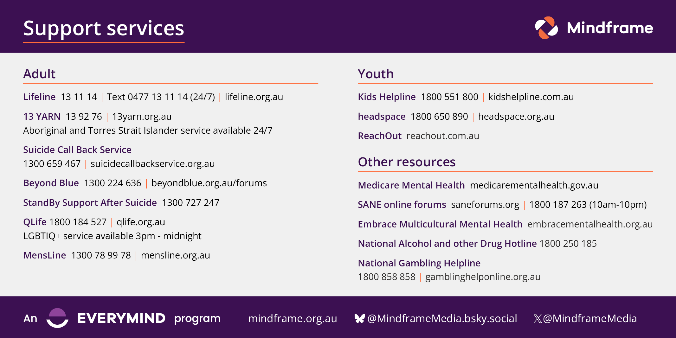
Help-seeking information

Slide 12
Task One: Group Discussion Activity
Once allocated a case study, students are to discuss the following questions:
What were some of the key or newsworthy points in the case study?
Should this story be reported? If yes, which supporting materials are most appropriate to refer to in a news story?
How can the ethical issues inherent in this story be balanced with journalistic and commercial values?
What considerations around language and framing choices can be made to minimise any risk of stigma or harm to audiences as well as to the people directly impacted in the case study?

Slide 13
Task Two: Individual News Writing Activity
Once all students have finished the class discussion, choose your individual task from the following list using the case study you worked on in the group activity:
News report: 200 words.
Feature article: 150-200 word plan outlining structure and key interviews.
Radio story: 30 second script with audio grab description
(Note: no audio is available for Case Study 4).
TV news story: Two-minute story script with outline of one interview and plan
for b-roll.
Instagram carousel: 10 slides of short text (25-35 words each) plus plan for
images, post description and tags.

